Slide 1
Introduction to EU Law
The four freedoms
Leonardo Pasqui
Dipartimento di Sociologia e Diritto dell’Economia – UNIBO
Jean Monnet Module «EULA – EU law for Algorithm»

Slide 2
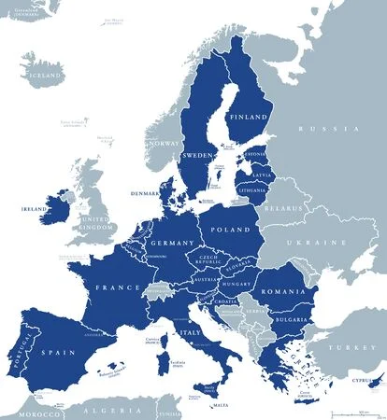
The single market
The single market of the EU is based on the four freedoms laid down in the EU Treaties
Free movement of workers
Free movement of goods
Freedom of establishment and freedom to provide services
Free movement of Capital
The aim is to ensure that moving from one country to another is as easy as inside a country. At the same time, the aim is also to ensure the protection of consumers, workers and the environment.

Slide 3
What is the EU Single Market?
LINK

Slide 4
European Single Market
The internal market of the European Union (EU) is a single market in which the free movement of goods, services, capital and persons is assured, and in which citizens are free to live, work, study and do business.
Since its creation in 1993, the single market has opened itself more to competition, created jobs, and reduced many trade barriers. The Single Market Act I-II was put forward in two parts, in 2011 and 2012, containing proposals to further exploit the opportunities afforded by the single market, in order to boost employment and improve confidence in European business.
The Single Market is all about bringing down barriers and simplifying existing rules to enable everyone in the EU to make the most of the opportunities offered to them by having direct access to 27 countries and 450 million people.
It is a unified trading territory that functions without the border regulations and tariffs which typically apply to trade between countries.

Slide 5
The process towards a single market
In the late 1970s, the European Economic Community, or Common Market, established by the Treaty of Rome (1957), had still not been completed. Intra-Community trade had, admittedly, been liberalised by the rapid elimination of quotas and by the gradual lowering of customs barriers. With regard to industrial products, liberalisation was completed on 1 July 1968. As for agricultural products, the common agricultural policy (CAP), in force since 1962, comprised a product-specific Community market organisation which established a unified market with guaranteed prices.
However, many obstacles to free movement still remained. Customs controls remained a necessity because of disparities between national legislations relating to quality, safety and hygiene standards.
Any country which deemed the manufacturing standards of another country inadequate was able to block imports. On 20 February 1979, in the Cassis de Dijon case (C-120/7), the Court of Justice had handed down a ruling that ‘any product lawfully produced and marketed in one Member State must, in principle, be admitted to the market of any other Member State.’ Derogations from this principle were admissible only under very strict conditions, but the Commission, having identified cases of unreasonable regulations, then had to refer them to the Court of Justice, which settled cases on an individual basis.

Slide 6
Free movement of goods
The free movement of goods, the first of the four fundamental freedoms of the internal market, is secured through the elimination of customs duties and quantitative restrictions, and the prohibition of measures having an equivalent effect.
The principles of mutual recognition, elimination of physical and technical barriers and promotion of standardisation were added in order to continue the completion of the internal market.
Legal basis
Article 26 and Articles 28-37 of the Treaty on the Functioning of the European Union (TFEU).
Objectives
The right to the free movement of goods originating in Member States, and of goods from third countries which are in free circulation in the Member States, is one of the fundamental principles of the Treaty (Article 28 of the TFEU). Originally, the free movement of goods was seen as part of a customs union between the Member States, involving the abolition of customs duties, quantitative restrictions on trade and equivalent measures, and the establishment of a common external tariff for the Union. Later on, the emphasis was placed on eliminating all remaining obstacles to the free movement of goods, with a view to creating the internal market.

Slide 7
Free movement of goods
The elimination of customs duties and quantitative restrictions (quotas) between Member States was accomplished by 1 July 1968. This deadline was not met in the case of the supplementary objectives – the prohibition of measures having an equivalent effect, and the harmonisation of relevant national laws. These objectives became central in the ongoing effort to achieve free movement of goods.
Prohibition of charges having an effect equivalent to that of customs duties: Article 28(1) and Article 30 of the TFEU
Prohibition of measures having an effect equivalent to quantitative restrictions: Article 34 and Article 35 of the TFEU (Cassis de Dijon and Dassonville)
Exceptions to the prohibition of measures having an effect equivalent to that of quantitative restrictions (art. 36 TFEU) -> should be proportional and justified.
Harmonisation of national legislation

Slide 8
Free movement of capital
It is not only the most recent one but, because of its unique third-country dimension, also the broadest. The liberalisation of capital flows progressed gradually. Restrictions on capital movements and payments, both between Member States and with third countries, have been prohibited since the start of 2004 as a result of the Maastricht Treaty, although exceptions may exist.
Legal basis
Articles 63 to 66 of the Treaty on the Functioning of the European Union (TFEU).
Objectives
All restrictions on capital movements between Member States as well as between Member States and third countries should be removed, with exceptions in certain circumstances. The free movement of capital underpins the single market and complements the other three freedoms. It also contributes to economic growth by enabling capital to be invested efficiently and promotes the use of the euro as an international currency, thus contributing to the EU’s role as a global player. It was also indispensable for the development of Economic and Monetary Union (EMU) and the introduction of the euro.

Slide 9
Free movement of capital: Capital market union
The capital markets union (CMU) is a economic policy initiative (plan) to create a single market for capital. The aim is to get money – investments and savings – flowing across the EU so that it can benefit consumers, investors and companies, regardless of where they are located.
A capital markets union will:
provide businesses with a greater choice of funding at lower costs and provide SMEs in particular with the financing they need
support the economic recovery post-Covid-19 and create jobs
offer new opportunities for savers and investors
create a more inclusive and resilient economy
help Europe deliver its new green deal and digital agenda
reinforce the EU’s global competitiveness and autonomy
make the financial system more resilient so it can better adapt to the UK’s departure from the EU

Slide 10
Free movement of workers
One of the four freedoms enjoyed by EU citizens is the free movement of workers. This includes the rights of movement and residence for workers, the rights of entry and residence for family members, and the right to work in another Member State and be treated on an equal footing with nationals of that Member State. Restrictions apply for the public service. The European Labour Authority serves as a dedicated agency for the free movement of workers, including posted workers.
Legal basis
Article 3(2) of the Treaty on European Union (TEU); Articles 4(2)(a), 20, 26 and 45-48 of the Treaty on the Functioning of the European Union (TFEU).
Objectives
Freedom of movement for workers has been one of the founding principles of the EU since its inception. It is laid down in Article 45 TFEU and is a fundamental right of workers, complementing the free movement of goods, capital and services within the European single market. It entails the abolition of any discrimination based on nationality as regards employment, remuneration and other conditions of work and employment. Moreover, this article stipulates that an EU worker has the right to accept a job offer made, to move freely within the country, to stay for the purpose of employment and to stay on afterwards under certain conditions.

Slide 11
Free movement of workers
The free movement of workers from several perspectives:
Workers’ rights of movement and residence (Directive 2004/38/EC): For the first three months, every EU citizen has the right to reside in the territory of another EU country with no conditions or formalities other than the requirement to hold a valid identity card or passport. For longer periods, the host Member State may require a citizen to register his or her presence within a reasonable and non-discriminatory period of time.
Employment: Regulation 492/2011 sets rules for employment, equal treatment and workers’ families. Any national of a Member State has the right to seek employment in another Member State in conformity with the relevant regulations applicable to national workers. Member States are not allowed to apply any discriminatory practices, such as limiting job offers to nationals or requiring language skills going beyond what is reasonable and necessary for the job in question.

Slide 12
Free movement of workers
Restrictions on freedom of movement: The Treaty allows a Member State to refuse an EU citizen the right of entry or residence on the grounds of public policy, public security or public health. Alongside, art. 45 TFEU states that the free movement of workers does not apply to employment in the public sector.
The mutual recognition of diplomas: Articles 26 and 53 TFEU. Mainly for professionals and self-employed but applicable to workers as a whole.

Slide 13
Freedom of establishment and freedom to provide services
The freedom of establishment and the freedom to provide services guarantee mobility of businesses and professionals within the EU.
Legal basis
Articles 26 (internal market), 49 to 55 (establishment) and 56 to 62 (services) of the TFEU.
Objectives
Self-employed persons and professionals or legal persons within the meaning of Article 54 TFEU who are legally operating in one Member State may: (i) carry out an economic activity in a stable and continuous way in another Member State (freedom of establishment: Article 49 TFEU); or (ii) offer and provide their services in other Member States on a temporary basis while remaining in their country of origin (freedom to provide services: Article 56 TFEU). This implies eliminating discrimination on the grounds of nationality and, if these freedoms are to be used effectively, the adoption of measures to make it easier to exercise them, including the harmonisation of national access rules or their mutual recognition (2.1.6).

Slide 14
Freedom of establishment and freedom to provide services
Main problem is Social dumping.
It is rather a set of practices on an international, national or inter-corporate level, aimed at gaining an advantage over competitors, which could have important negative consequences on economic processes and workers’ social security.
Examples include actions taken by actors from 'low wage' Member States to gain market advantage over actors from Member States with higher pay and social standards; multinational companies from 'high wage' countries searching for ways to avoid legal constraints by employing subcontractors from low-wage countries; and companies engaging cheaper and more vulnerable temporary and agency workers, or relocating production to lower wage and less regulated locations.
Social dumping takes different forms in different sectors. Suppressing social dumping is a component of different regulations on working mobility, undeclared work, and the status of transport workers.

Slide 15
Border regions
EU internal border regions...
Cover 40% of the EU territory
Account for 30% of the population – 150 million people
Produce 30% of the EU's GDP
Host almost 2 million cross-border commuters, 1,3 million of which are cross border workers representing 0.6% of all persons employed across the EU

Slide 16
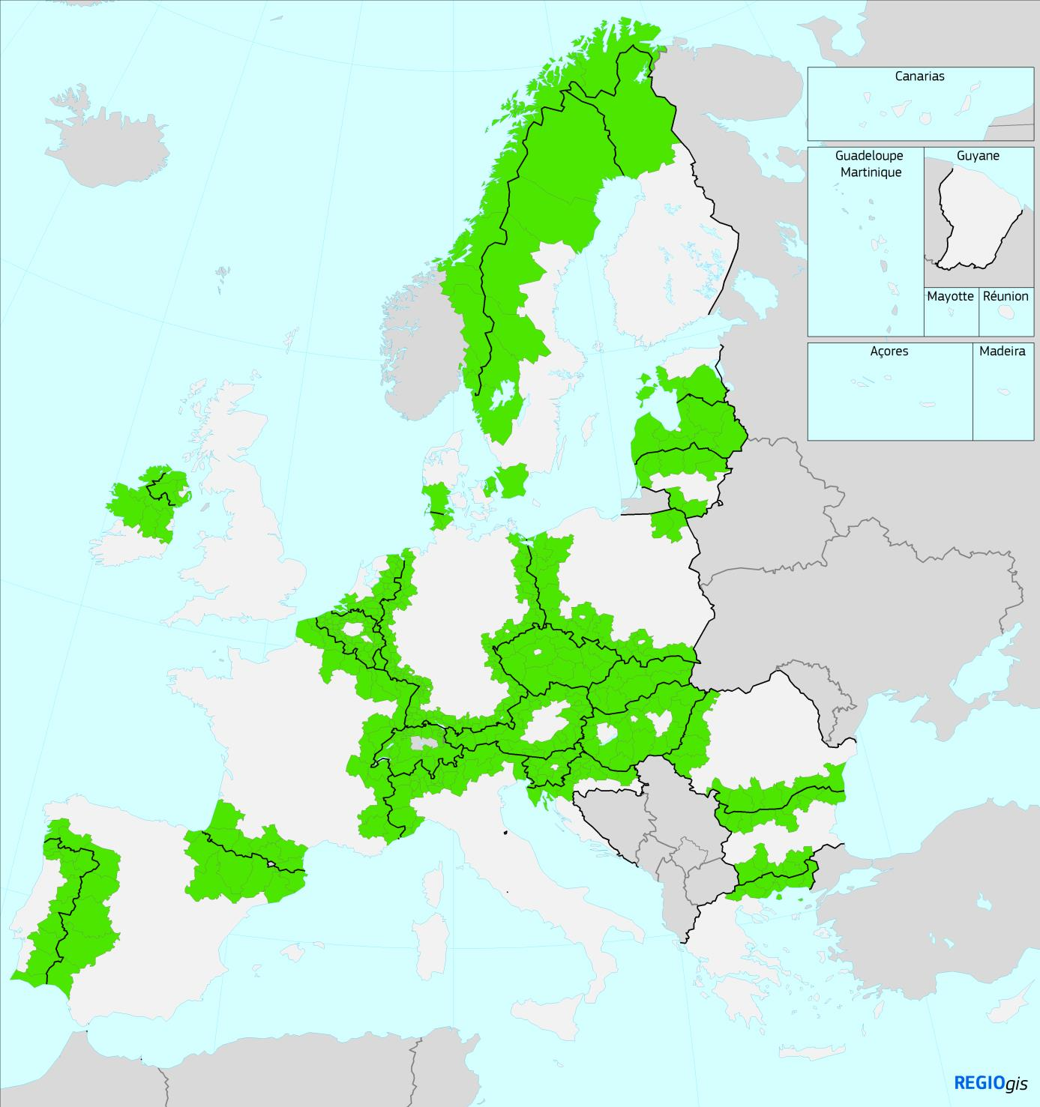
Border Regions

Slide 17
Border regions
As a matter of fact “evidence gathered by the Commission demonstrates that border regions generally perform less well economically than other regions within a Member State.
Access to public services such as hospitals and universities is generally lower in border regions. Navigating between different administrative and legal systems is often still complex and costly. Individuals, businesses, public authorities and non-governmental organisations have shared with the Commission their at times negative experiences of interaction across internal borders”.
COM(2017) 534 final

Slide 18
Leonardo Pasqui
leonardo.pasqui2@unibo.it

